Slide 1
WELCOME
to My DEPI Project

Slide 2


Manufacturing Downtime
Project
presented by:
Shaimaa Mohamed
Malak Hani
Nayra Atef
Fares Mohamed
Data Source: Real factory logs provided by DEPI

Slide 3
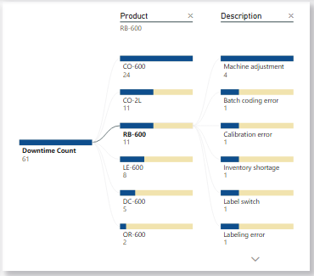
Project Idea
Problem
Production downtime was happening frequently and without clear patterns. The same issues kept appearing across different lines, but there was no structured data to identify the root cause. Some products had much higher downtime than others. Certain shifts showed a clear increase in unplanned stops. Management couldn’t make informed decisions due to lack of visibility.

Slide 4
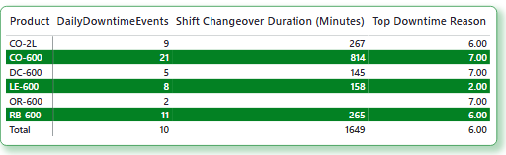
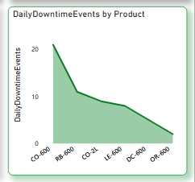
Proposed Solution: To address the recurring downtime issues identified in our analysis, we propose the following data-driven solution: Data Analysis and Monitoring: Conduct comprehensive data analysis to pinpoint the primary downtime causes, focusing on product lines, shifts, and specific operational processes. Leverage historical data to identify patterns and predict potential downtime events.
Centralized Dashboard Implementation
Develop a centralized dashboard that consolidates key downtime metrics, including:
Top 5 products with the highest downtime
Most common downtime reasons
Peak downtime periods by shift
The dashboard will provide a clear visual representation of problem areas, enabling quick identification and targeted action
Preventive Action Recommendations:
Example Based on the insights generated, recommend targeted preventive actions to minimize downtime
If a specific product line shows consistent downtime due to mechanical failure, implement a predictive maintenance schedule.
9 may 2025

Slide 5
Learning from Real-World Applications: Similar to SCG Chemicals' successful implementation of a centralized data platform, our proposed solution leverages data analysis to transform fragmented information into actionable insights. By identifying recurring downtime patterns, we can prioritize intervention areas and ultimately reduce operational disruptions.
Unique Value – Real-World Example
SCG Chemicals: Achieving Near-Zero Downtime
SCG Chemicals, a leading petrochemical company in Thailand, implemented a Digital Reliability Platform to address recurring production downtimes. Partnering with AVEVA, they developed a centralized data platform that transformed scattered data into actionable insights.
Results Achieved:
Increased plant reliability from 98% to nearly 100%
Reduced maintenance costs by 40%
Achieved a 9x return on investment by preventing asset failures
Accelerated data access to less than 10 seconds

Slide 6
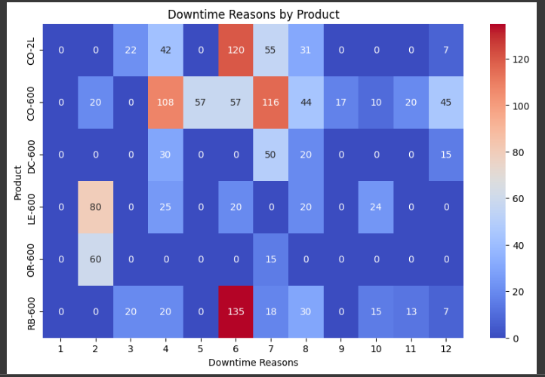
Implementation Highlights:
AI-powered predictive monitoring and analytics
Comprehensive asset management system
3D digital model for operational visibility
Centralized Digital Reliability Center for data integration
Relevance to Our Project:
Our project adopts a similar approach by integrating data analysis to uncover patterns in downtime.
By analyzing downtime across products, operators, and shifts, we aim to provide actionable insights to minimize disruptions.
Just like SCG, we use data to identify root causes and prioritize improvement areas, ensuring targeted and effective interventions.
9 may 2025

Slide 7
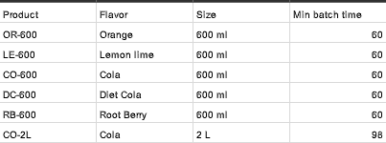
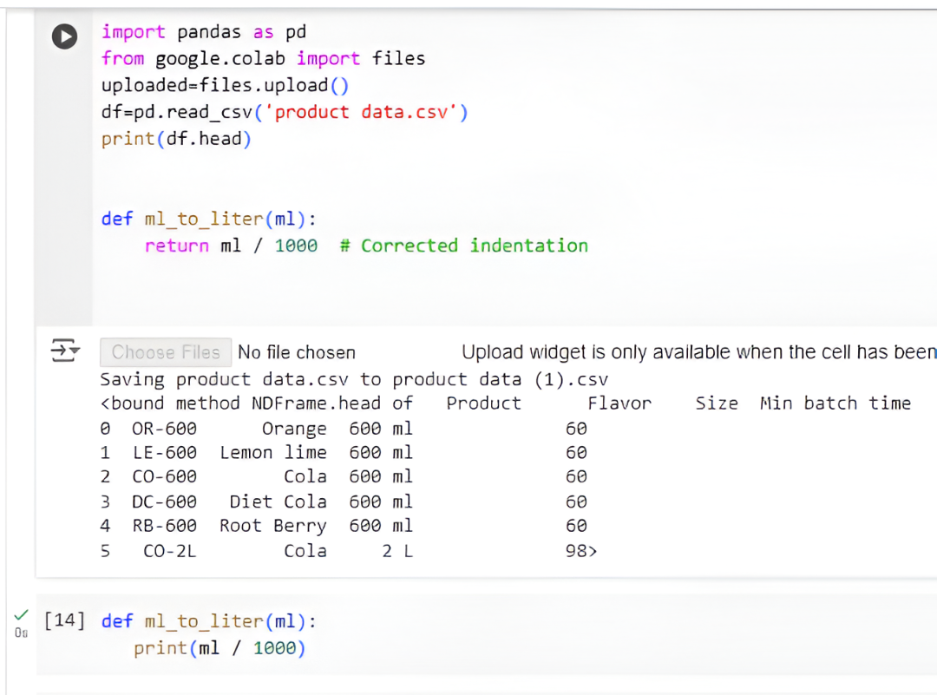
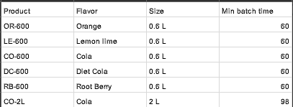
Data Cleaning
Different units in size column are detected
Process:
Data cleaning to unite all units using python , we used the code ,"Def ml_to_liter (ml):
Print(ml/1000)" To convert any ml and L
Output:
Structured , cleaned data with united units giving clear , accurate insights

Slide 8
From DATA Exploring some busniess Q are conducted:
1-Do certain products require longer operation times?
( CO-21 HAS THE HIGHEST TOME ABOUT 98 MIN)
2- DO Certain Product Higher Size?
(CO-21 HAS THE BIGGEST SIZE ABOUT 2L)

Slide 9
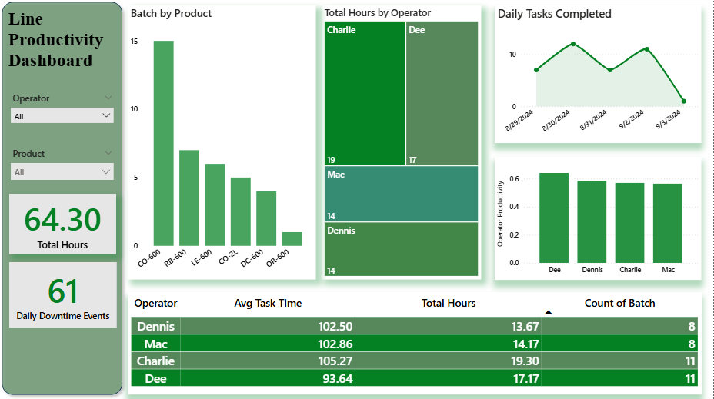

Slide 10
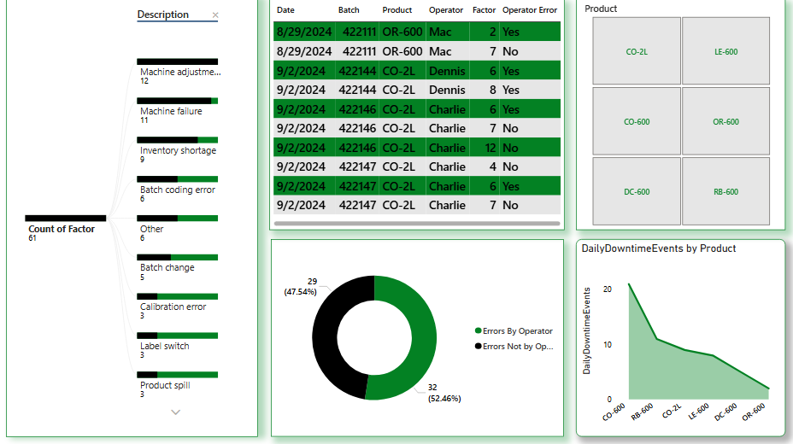

Slide 11
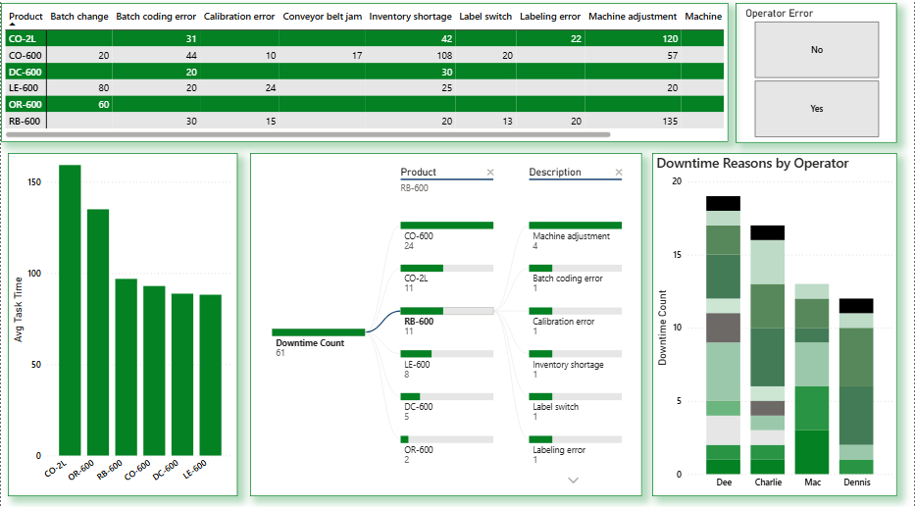

Slide 12
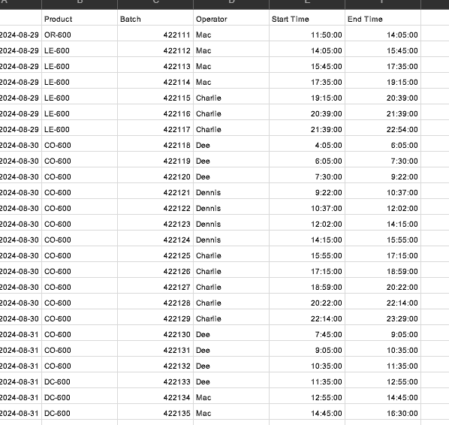
Database Architecture: Data is stored in Excel files. Each file represents a separate entity (Products, Manufacturing Line Productivity, Downtime Factors, Line Downtime). Python was used for data cleaning and preparation. Data was transferred to Power BI for analysis and dashboard creation. Key Entities and Relationships Products: Contains product data (Flavor, Product, Size). Manufacturing Line Productivity: Production data for each line (Batch, Operator, Start Time, End Time, Date, Product, Downtime). Downtime Factors: Downtime reasons and their descriptions (Factor, Description, Operator Error). Line Downtime: Downtime details for each batch (Batch, Downtime Factor). Relationships between files: Products is linked to Manufacturing Line Productivity through the Product column. Manufacturing Line Productivity is linked to Line Downtime through the Batch column. Line Downtime is linked to Downtime Factors through the Downtime Factor column.
Data Structure

Slide 13
Data Flow Data Collection: Data was collected from four Excel files (Products, Manufacturing Line Productivity, Downtime Factors, Line Downtime). Data Processing: Python: Standardized product sizes and added the Downtime column. Data Analysis: Power BI: Created a dashboard that includes: Productivity rates for each line. Most common downtime reasons. Time analysis of downtimes and productivity. CSV/Excel File Structure Products: 3 columns (Flavor, Product, Size) - Approximately 10 rows. Manufacturing Line Productivity: 7 columns (Batch, Operator, Start Time, End Time, Date, Product, Downtime) - Approximately 40 rows. Downtime Factors: 3 columns (Factor, Description, Operator Error) - Approximately 10 rows. Line Downtime: 2 columns (Batch, Downtime Factor) - Approximately 30 rows.
9 may 2025
9 may 2025

Slide 14
Deliverables
Reports and Documentation:
Technical Specifications Report – Outlines the technical structure of the proposed solution.
Data Analysis Report – Details the findings from data analysis, including downtime patterns and key insights.
User Manual – A step-by-step guide for using the dashboard and interpreting the data.
Implementation Plan – A detailed roadmap for applying the solution, including key milestones.
Final Presentation – Summarizes the project, findings, and recommendations.
Timeline for Deliverables:
Week 1-2: Data Analysis Report
Week 3: Implementation Plan
Week 4: Dashboard Development
Week 5: User Manual
Week 6: Final Presentation + Feedback
Final Products:
Interactive Power BI Dashboard – Visual representation of key downtime metrics and recommendations.
Python Analysis Scripts – Source code for data analysis and downtime calculation.
Complete Documentation Folder – Includes all reports, manuals, and final presentation slides.
9 may 2025

Slide 15




Project Team
Malak Hani Data Analyst
documentation, data Cleaning, and preparing final presentation slides.
Shaimaa Mohamed– Data Visualization Specialist
Designing and developing Power BI dashboard.
Fares Mohamed – Data Analyst
Data analysis using Python, report generation, insights presentation and Data Visualization.
Nayra Atef – Data Analyst
Data Preparation , Data cleaning, and preparation for analysis.
9 may 2025

Slide 16
Thank You for Your Attention
Contact Information:
Shaimaa Mohamed – Data Visualization Specialist
Email: shaimaamohamed561@gmail.com
LinkedIn: LinkedIn Profile
Malak Hani – Documentation & Reporting
Email: malakhany01520@gmail.com
LinkedIn: LinkedIn Profile
Collaboration Methods:
Communication Tools: Microsoft Teams, WhatsApp , Zoom Meeting
File Sharing: Google Drive
Weekly Standup Meetings: Thursdays – Review progress, adjust timelines, and align tasks.
Nayra Atef – Data Preprocessing Specialist
Email: Nayra.atef@msa.edu.eg
LinkedIn: LinkedIn Profile
Fares Mohamed – Data Analyst
Email:faresmohamed66650049@gmail.com
LinkedIn: LinkedIn Profile
9 may 2025

